Slide 1
Flood & Hurricanes
By: Raegan & Brianna P-5

Slide 2
What to do if there happens to be a hurricane or flood
-Stay indoors and away from windows and glass doors.
-Close all interior doors , secure and brace external doors.
- Turn off propane tanks, avoid using the phone , except for serious emergencies.

Slide 3
What not to do if there is a hurricane or flood
-Don’t wander around outside
-Avoid your basement
-Don’t sleep or spend time in rooms susceptible to tree falls

Slide 4
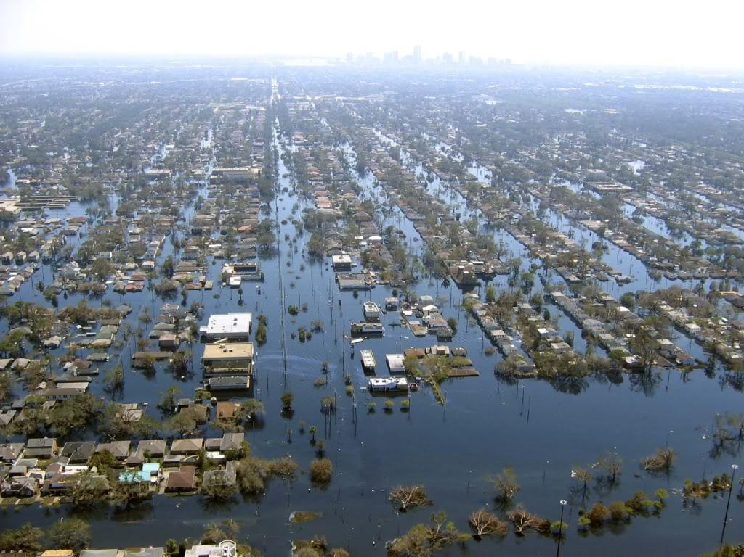
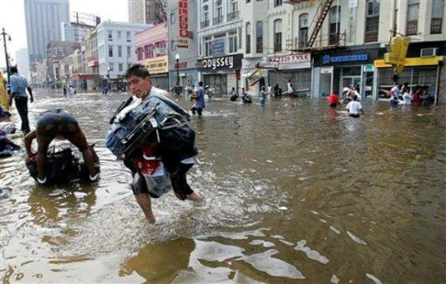
After hurricane katrina Eastern Northern America

Slide 5
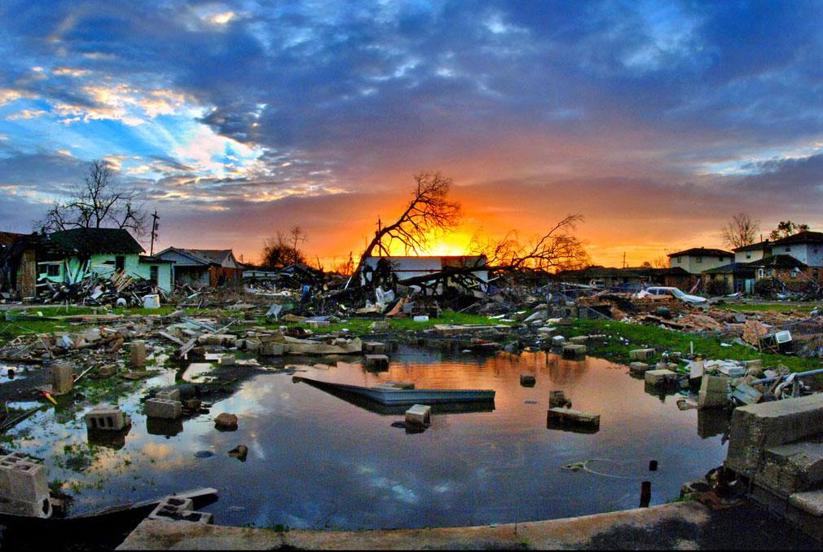

Slide 6
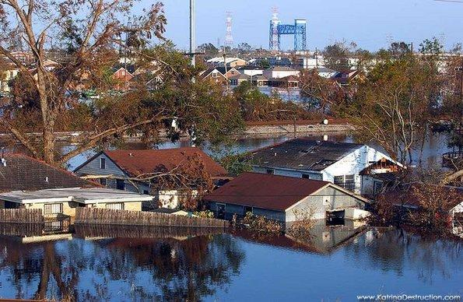
Pictures of Floods

Slide 7
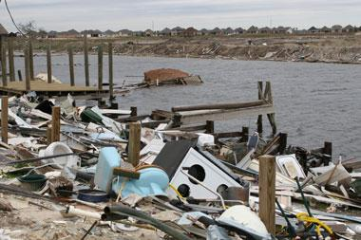
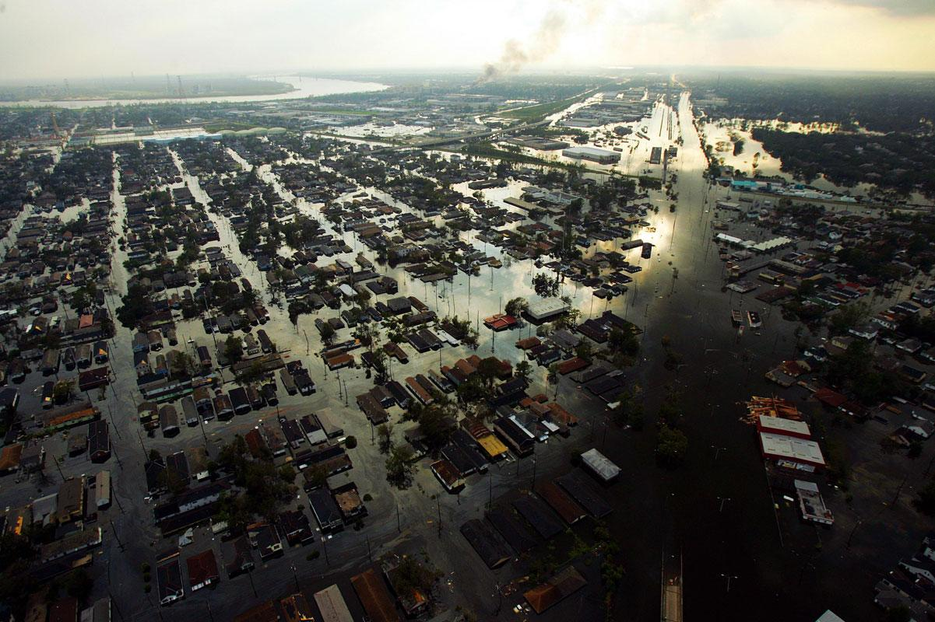
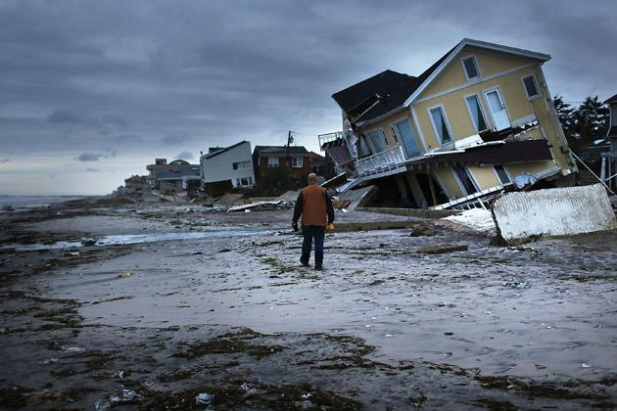
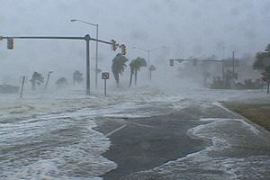

Slide 8
Links to videos
https://www.youtube.com/watch?v=ooGsvj5SeHE
https://www.youtube.com/watch?v=t_H4ZuJCTKQ

